Slide 1
Lecture 13
Requirements Modeling:
  Class-based Model
    Collaboration diagram
BSSE (Software Engineering-I) SZABIST-Islamabad

Slide 2
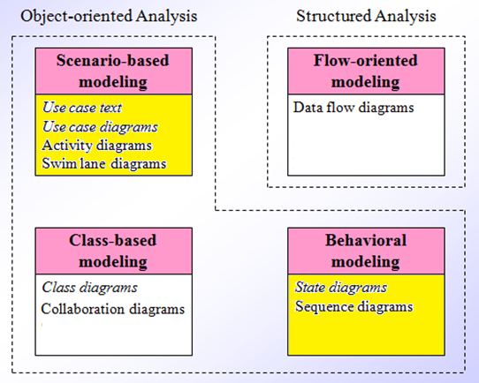
Requirement Analysis
BSSE (Software Engineering-I) SZABIST-Islamabad

Slide 3
Collaboration Diagram
Collaboration diagrams illustrate interactions between objects
The collaboration diagram illustrates messages being sent between classes and objects (instances).
Collaboration diagrams express both the context of a group of objects (through objects and links) and the interaction between these objects (by representing message broadcasts)

Slide 4
Collaboration Diagram
The communication is implicit in a Sequence Diagram, rather than explicitly represented as in a Communication Diagram
Communication Diagrams, formerly called Collaboration Diagrams.

Slide 5
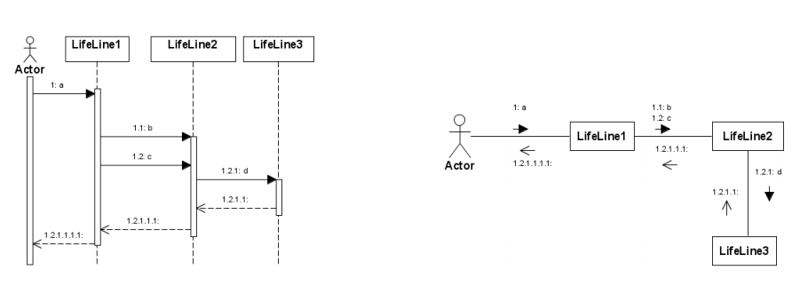
Collaboration Diagram

Slide 6
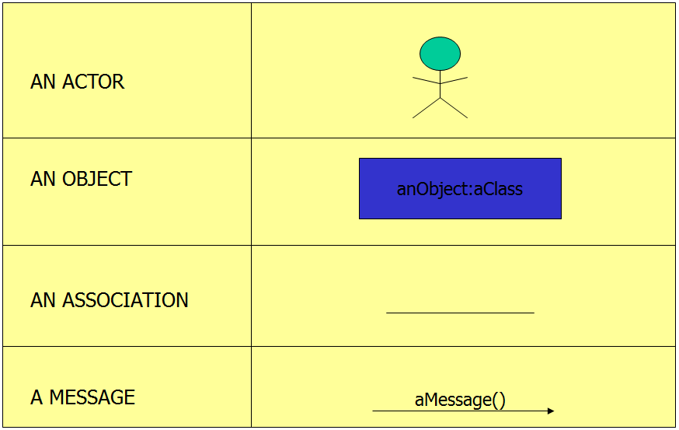
Collaboration Diagram Syntax

Slide 7
Elements of Collaboration Diagram
There are three primary elements of a collaboration diagram:
  Objects/Actors
  Links/Association
  Messages

Slide 8
Objects
Objects­ rectangles containing the object signature ­object signature:
  object name : object Class
  object name (optional) - starts with lowercase letter
  class name (mandatory) - starts with uppercase letter
Objects connected by lines ­actor can appear
Objects participating in a collaboration come in two flavors—supplier and client(source and sink)
  Supplier objects are the objects that supply the method that is being called, and therefore receive the message
  Client objects call methods on supplier objects, and therefore send messages

Slide 9
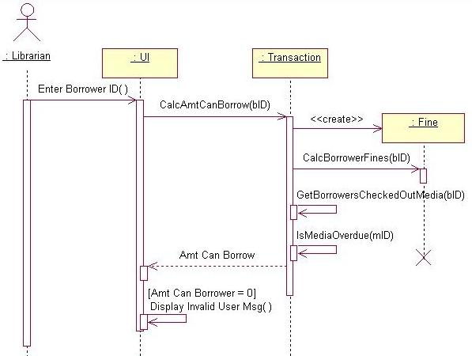
Example - Sequence Diagram

Slide 10
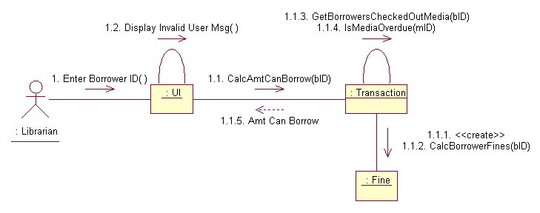
Object - Example
Transaction object acts as a Supplier to the UI (User Interface) Client object. In turn, the Fine object is a Supplier to the Transaction Client object.

Slide 11
Links
The connecting lines drawn between objects are links
They enable you to see the relationships between objects
This symbolizes the ability of objects to send messages to each other
A single link can support one or more messages sent between objects

Slide 12
Links - Example
The visual representation of a link is a straight line between two objects. If an object sends messages to itself, the link carrying these messages is represented as a loop icon. This loop can be seen on both the UI object and the Transaction object.

Slide 13
Message
An interaction is implemented by a group of objects that collaborate by exchanging messages
Messages in collaboration diagrams are shown as arrows pointing from the Client object to the Supplier object.
Typically, messages represent a client invoking an operation on a supplier object
Message icons have one or more messages associated with them
Messages are composed of message text prefixed by a sequence number
Time is not represented explicitly in a collaboration diagram, and as a result the various messages are numbered to indicate the sending order

Slide 14
Types of Messages
Procedural or Synchronous: A message is sent by one object to another and the first object waits until the resulting action has completed.
Asynchronous: A message is sent by one object to another, but the first object does not wait until the resulting action has completed.
Flat: Each arrow shows a progression from one step to the next in a sequence. Normally the message is asynchronous.
Return: the explicit return of control from the object to which the message was sent.

Slide 15
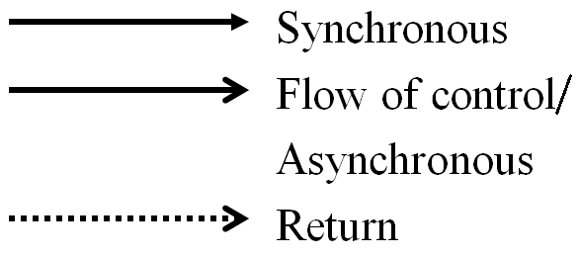
Message Flow Notation

Slide 16
Flow by Number

Slide 17
Flow by Number
1. Enter Borrower ID
1.1 CalcAmtCanBorrow
1.1.1 <<create>>
1.1.2 CalcBorrowerFines
1.1.3 GetBorrowersCheckedOutMedia
1.1.4 IsMediaOverdue
1.1.5 Amt Can Borrow
1.2 Display Invalid User Msg

Slide 18
Iterating Messages
Collaboration diagrams use syntax similar to sequence diagrams to indicate that either a message iterates (is run multiple times) or is run conditionally
  An asterisk (*) indicates that a message runs more than once
  Or the number of times a message is repeated can be shown by numbers (for example, 1..5)

Slide 19
Conditional Messages
To indicate that a message is run conditionally, prefix the message sequence number with a conditional [guard] clause in brackets [ x = true ]:
  [IsMediaOverdue]
This indicates that the message is sent only if the condition is met

Slide 20
Example
Sequence diagram is better at ‘time ordering’

Slide 21
Example
Collaboration diagram is better at showing the relationship between objects

Slide 22
Levels of Communication Diagrams
Specification level shows generic cases of collaborations (communications) Generic form captures a collaboration among class roles and association roles and their interactions
Instance level shows a specific instance of an interaction taking place and involving specific object instances Instance form captures a scenario among objects conforming to class roles and links conforming to association roles

Slide 23
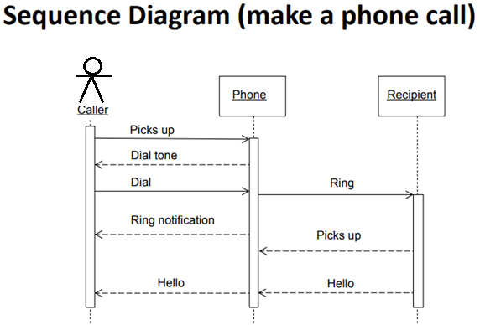
Create a Sequence diagram?

Slide 24
Create a Collaboration diagram?

